Slide 1
Create Your Own Personalized Augmented Reality Content: It's Easier than You Think!
By Courtney Pepe

Slide 2

About Me
High school teacher in Middlesex County, NJ AKA The Jersey Shore
7 years of sound educational experience in which I have taught every single grade from K to 12
Frequent Tweeter @ipadqueen2012
Educational Blogger: all of the apps in this webinar will be featured in more detailed post on my blog this week http://mrspepe.com/

Slide 3
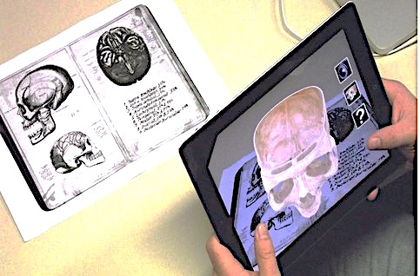
What is Augmented Reality?
Augmented Reality is a technology that superimposes a computer generated image on a user’s view of the real world, thus providing a composite view
We scan a 2D learning object with an AR app and something 3D or 4D pops up
2 types of AR apps- apps that feature pre-made AR and apps that we design our own AR for our classes

Slide 4

LAYAR

Slide 5
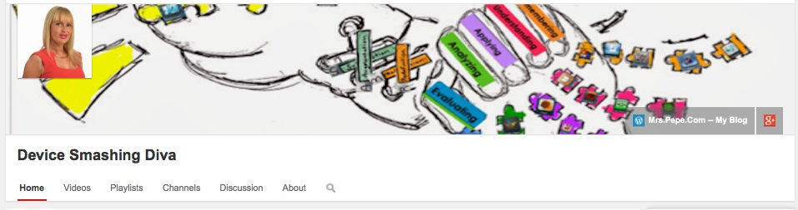
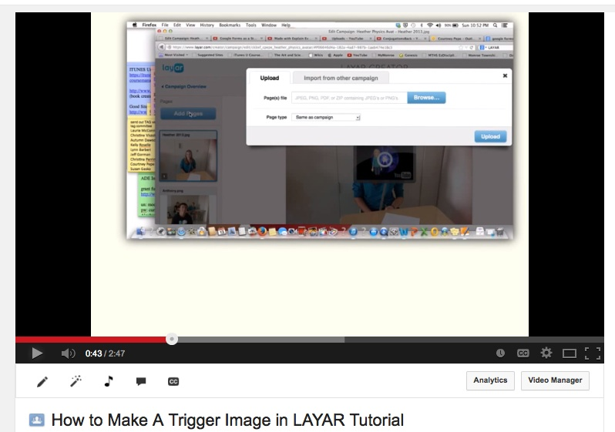
There are video tutorials for all of the procedures we cover today on my You Tube Channel…
http://tinyurl.com/mnpf382

Slide 6
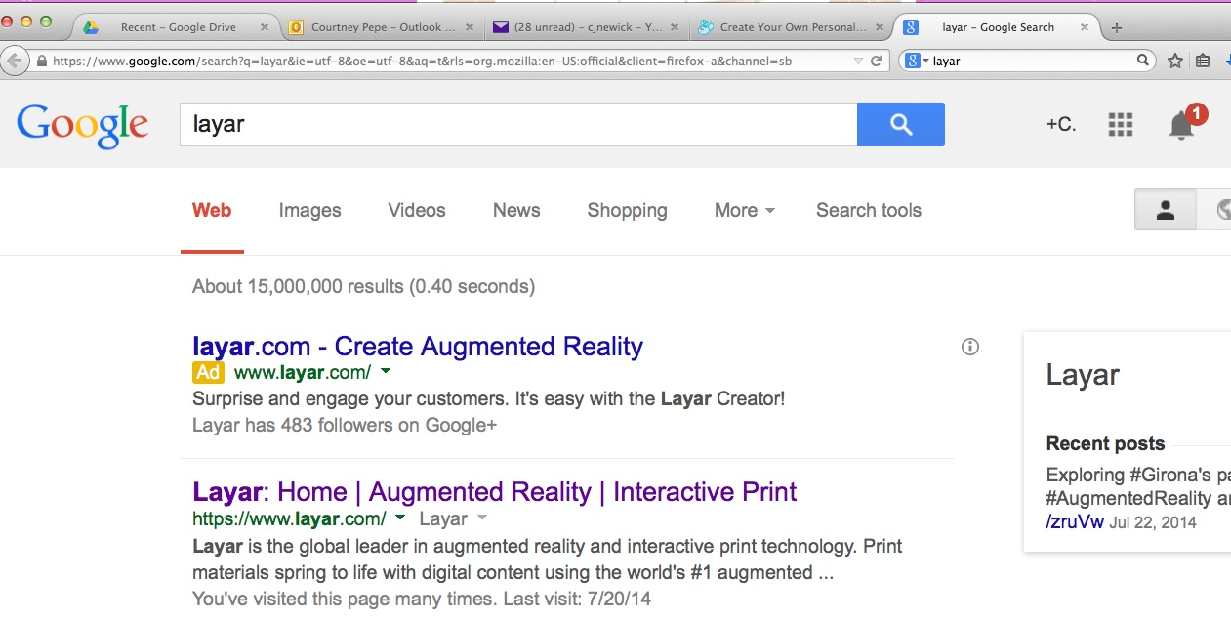
Let’s Make AR – in the Search Engine Type in LAYAR

Slide 7
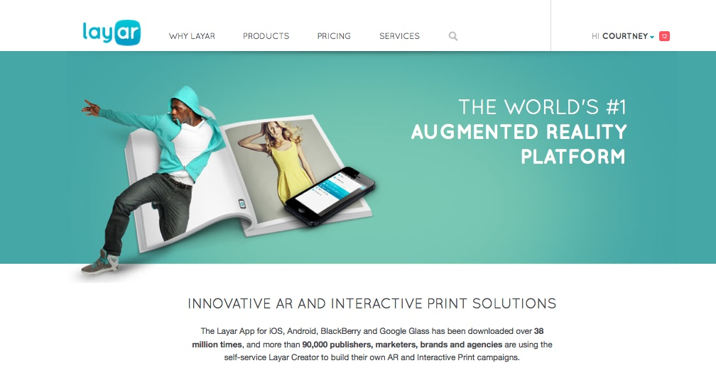
It will take you to the following website… https://www.layar.com/

Slide 8
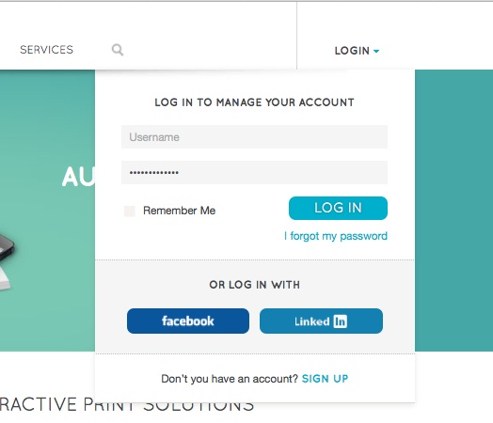
Hover on the LOGIN button and then click on the sign up text

Slide 9
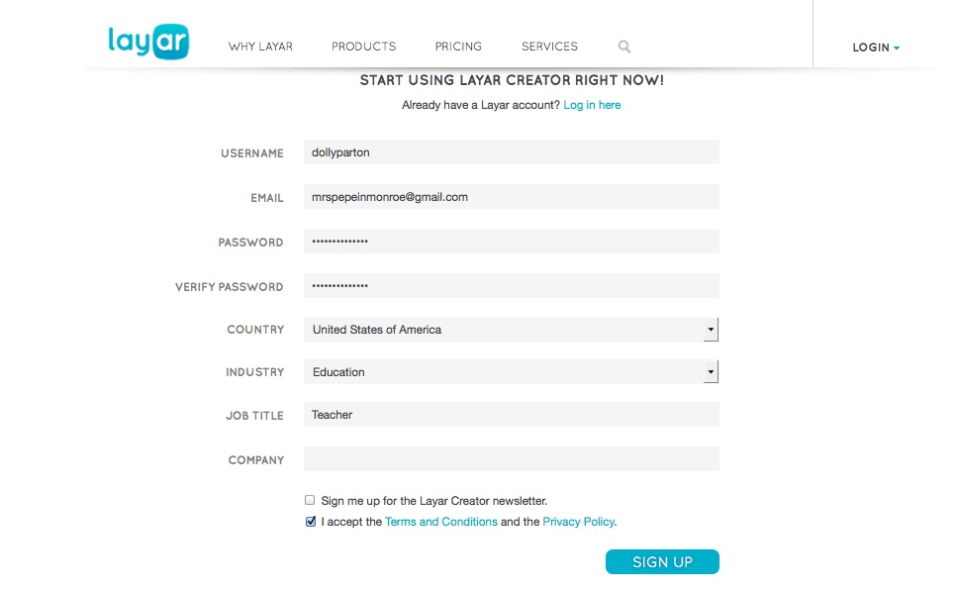
Then you will be prompted to create a profile

Slide 10
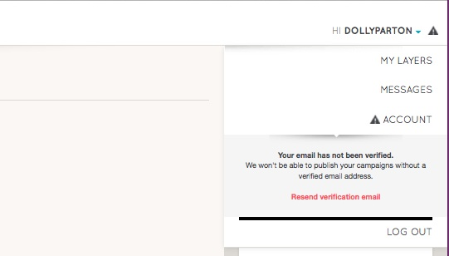
Once you sign up make sure you have received a verification email or you will not be able to publish your campaigns

Slide 11
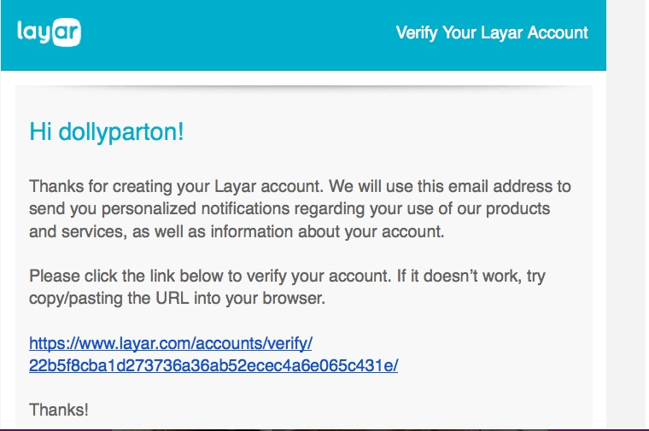
The verification email make take 5 to 10 minutes to go through… so be patient

Slide 12
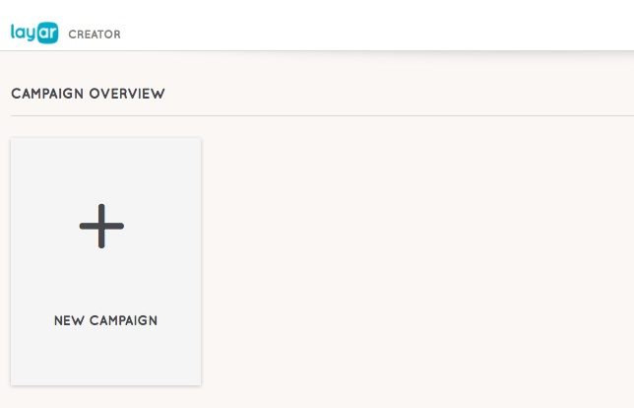
Press the Plus Button to Create a New Campaign

Slide 13
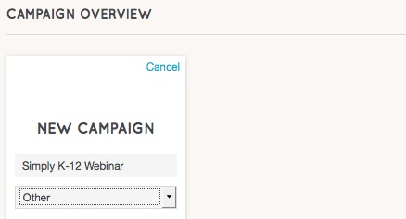
You Will be Asked to Title Your Campaign and Pick an Option from the Drop Down Menu

Slide 14
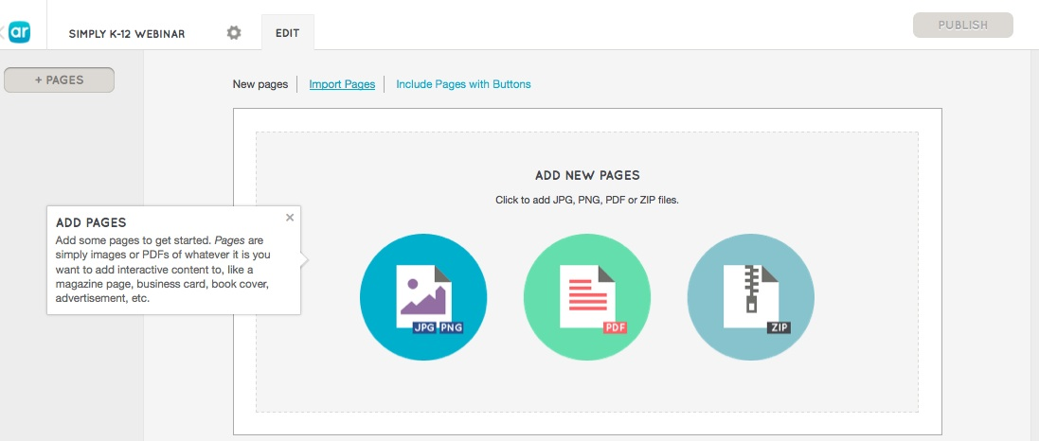
Then you are going to add pages to your campaign by selecting the jpeg, pdf, or zip file option…

Slide 15
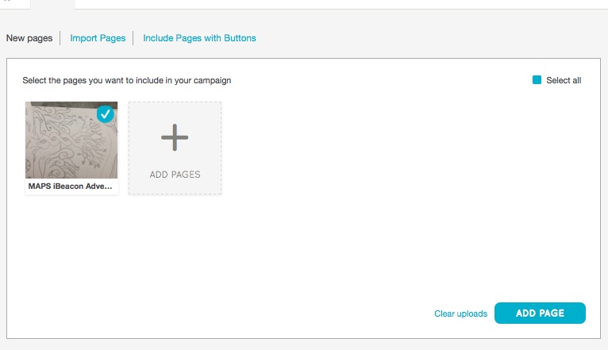
Then you choose a file from your desktop, the blue plus sign indicates that file has the right specs to be a trigger image

Slide 16
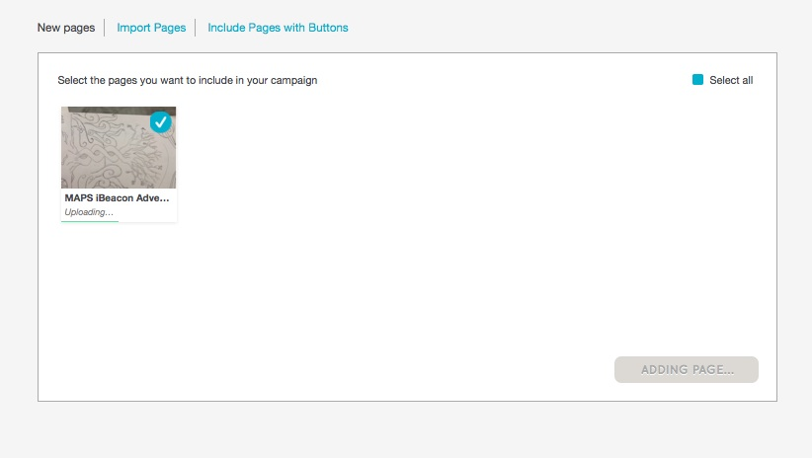
Then you are going to click on the Add Page Button to Mix Your 2D with Your 3D

Slide 17
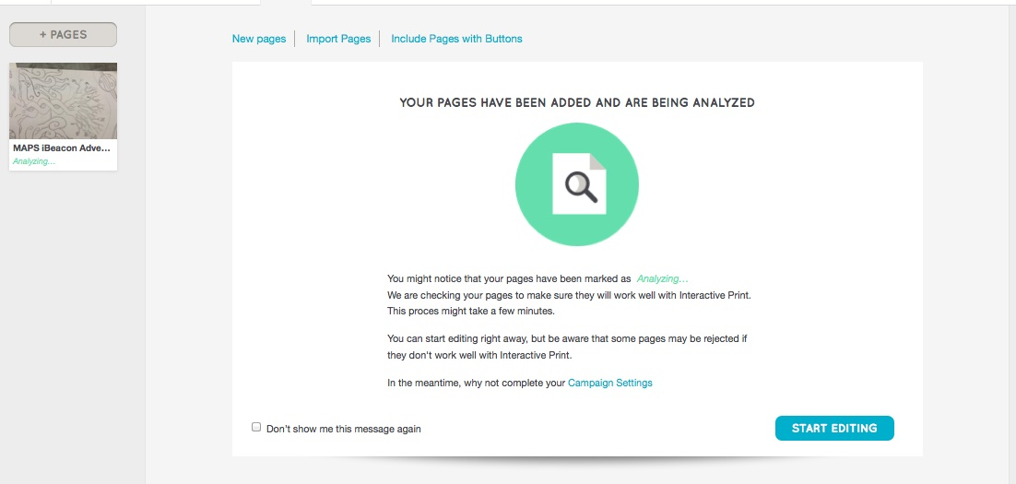
Then you will see your 2D “trigger image on the left hand side of the screen

Slide 18
At this point you will click on the start editing button to add 3D content to your 2D image

Slide 19
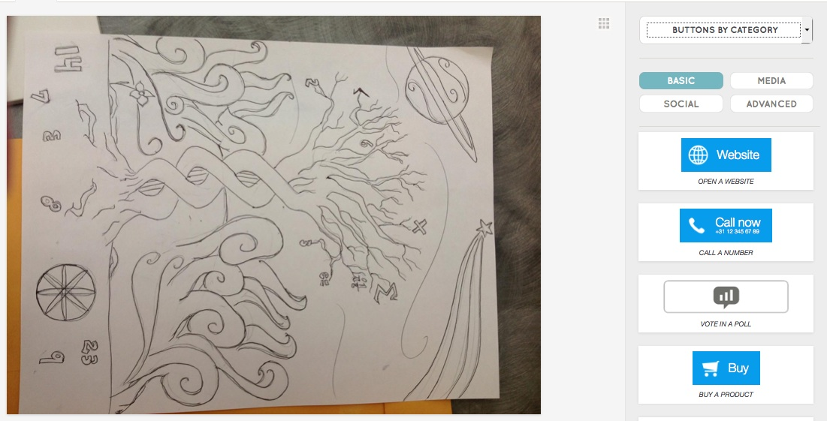
The program will analyze your image and now it is time to add buttons…

Slide 20

Buttons come in four different categories…

Slide 21
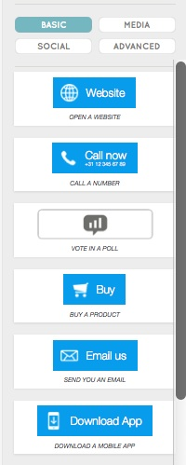
BASIC
Basic buttons are all free and allow you to add things like hyperlinks and polls on top of your image

Slide 22
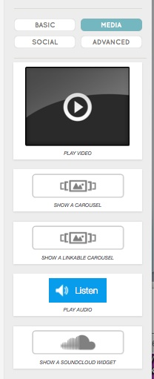
MEDIA
Media buttons have the power to transform the learning space
I use a lot of You Tube flipped classroom videos with content I have created
Also, reading teachers I have worked with have done interesting things with the Sound Cloud widgets

Slide 23
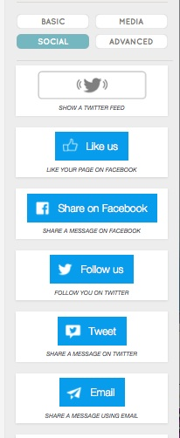
SOCIAL BUTTONS
Social buttons can lead the the user to Tweeter, email, and Facebook
I used to have Augmented Reality business cards which included a button that took the person scanning the business card to the #appsmash tweets on Twitter

Slide 24
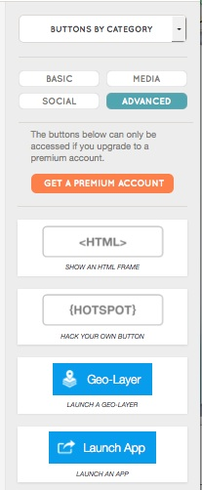
ADVANCED
I don’t use these because I don’t like to pay for things but I thought I would present it
You can do things like Launch APPS within the AR and put HTML code on as well

Slide 25
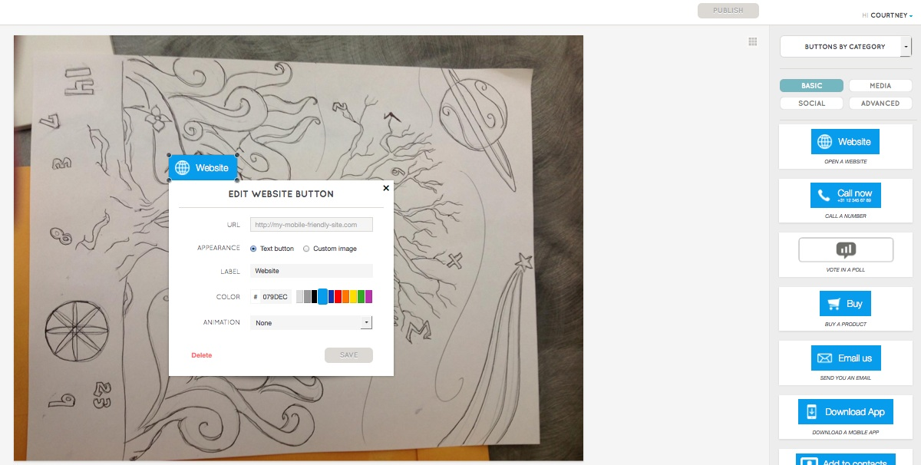
We will start with a basic button, the hyperlink
You click and drag
the website button from the
right hand side of the screen
onto the jpeg that you have
uploaded

Slide 26
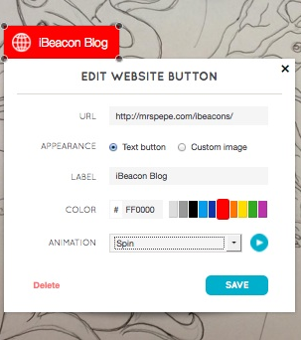
Next You Customize the Hyperlink Button
Cut and paste the url that you wish to use
You can change the label by typing in your own text
You can also change the color of the button
You can also animate the button

Slide 27
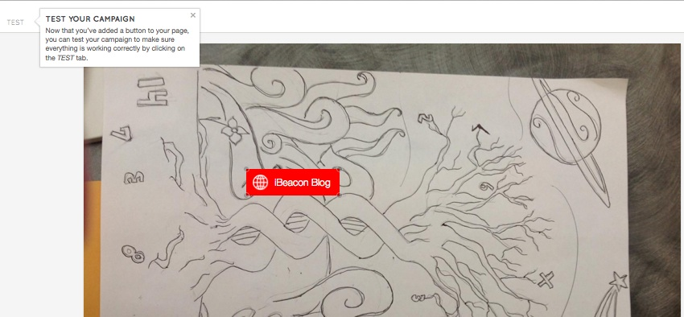
Now we have to test our campaign by clicking on the test icon in the upper left-hand corner of the screen

Slide 28
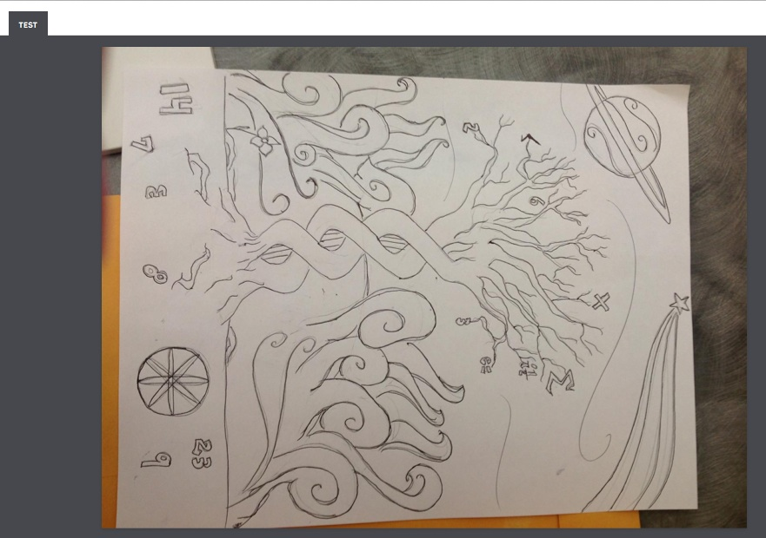
When you are testing you will open the LAYAR app on your phone/tablet

Slide 29
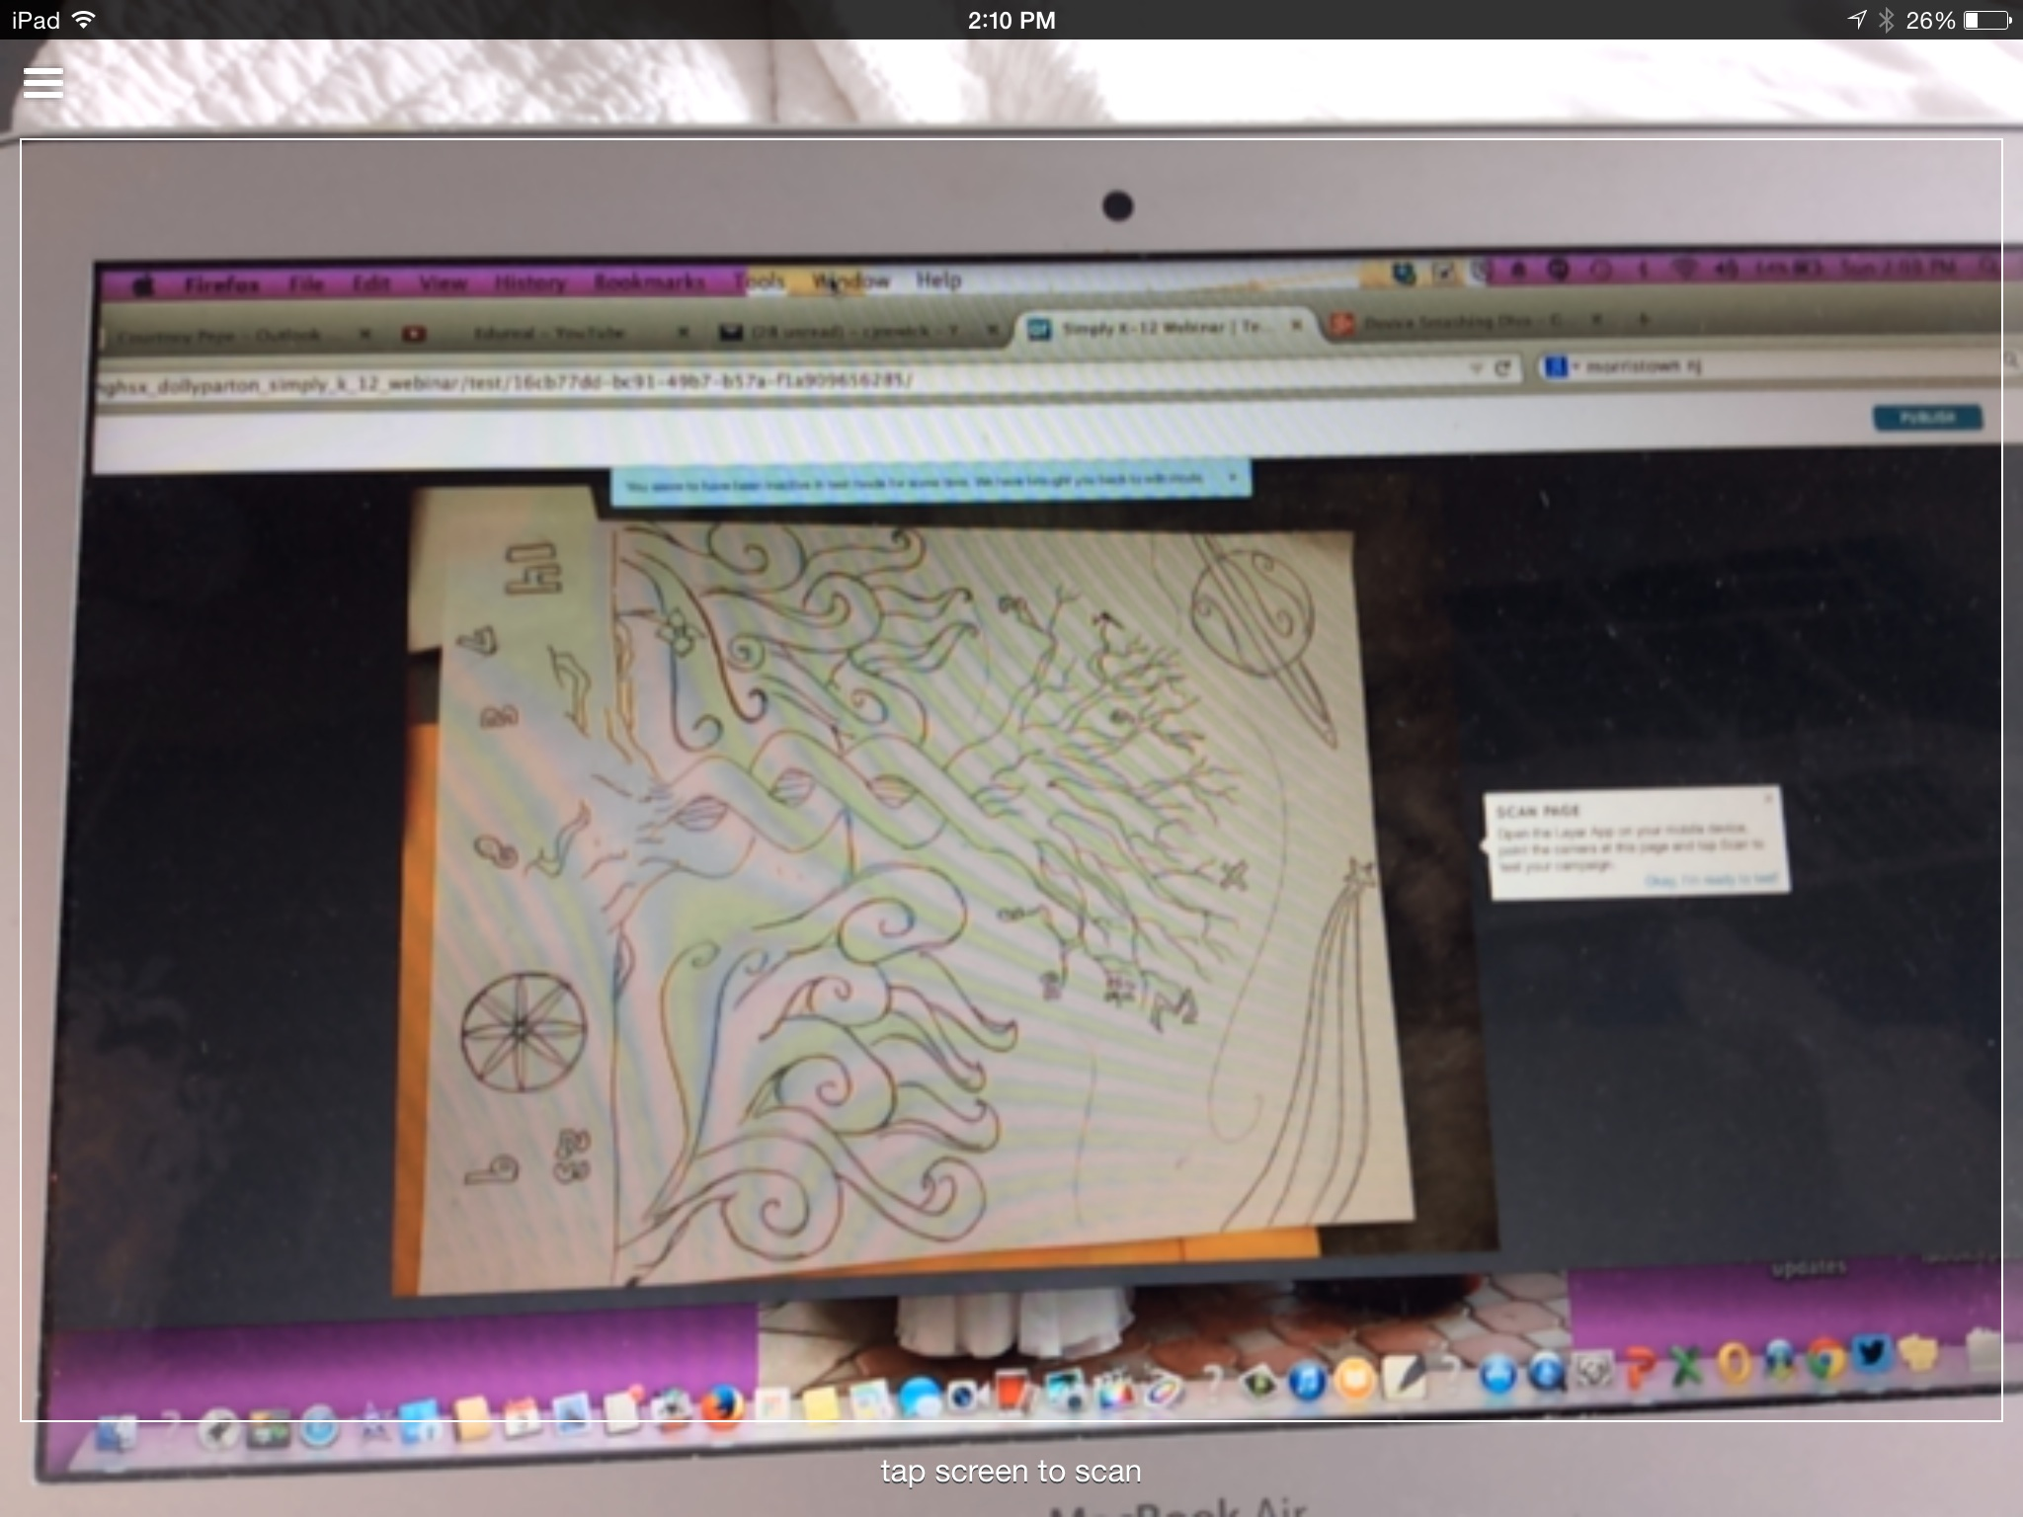
This is a screenshot of my iPad scanning the trigger on the computer for AR content, note how it it says tap screen to scan on the bottom

Slide 30
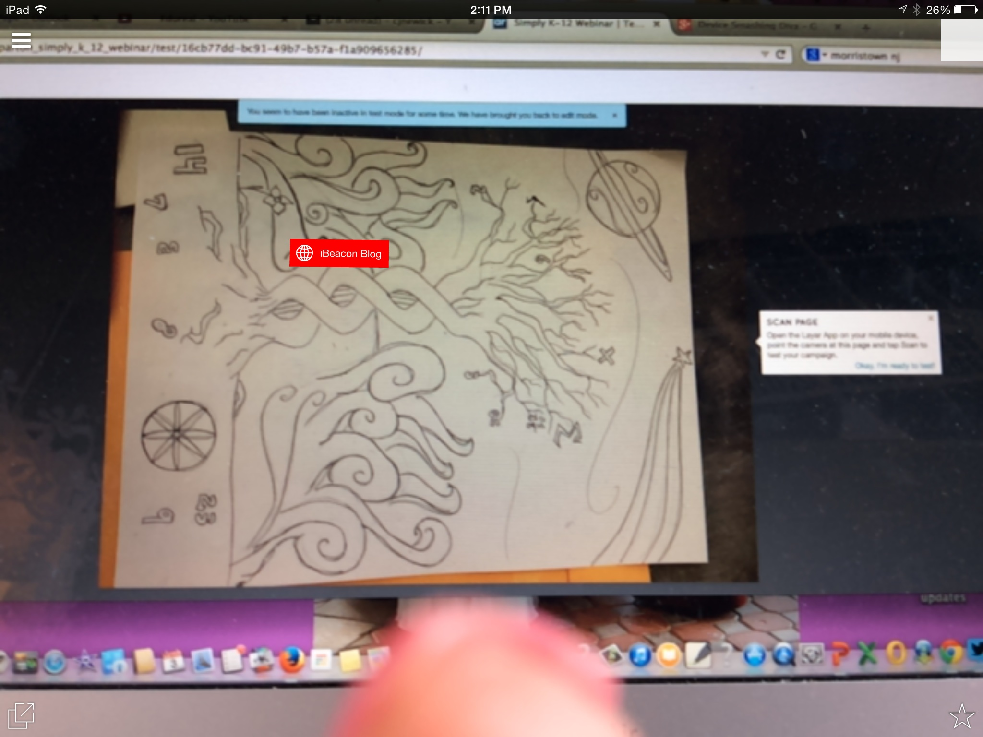
Once you scan for content on your phone or tablet the buttons will pop up and you reach out and touch them (see my finger ☺)

Slide 31
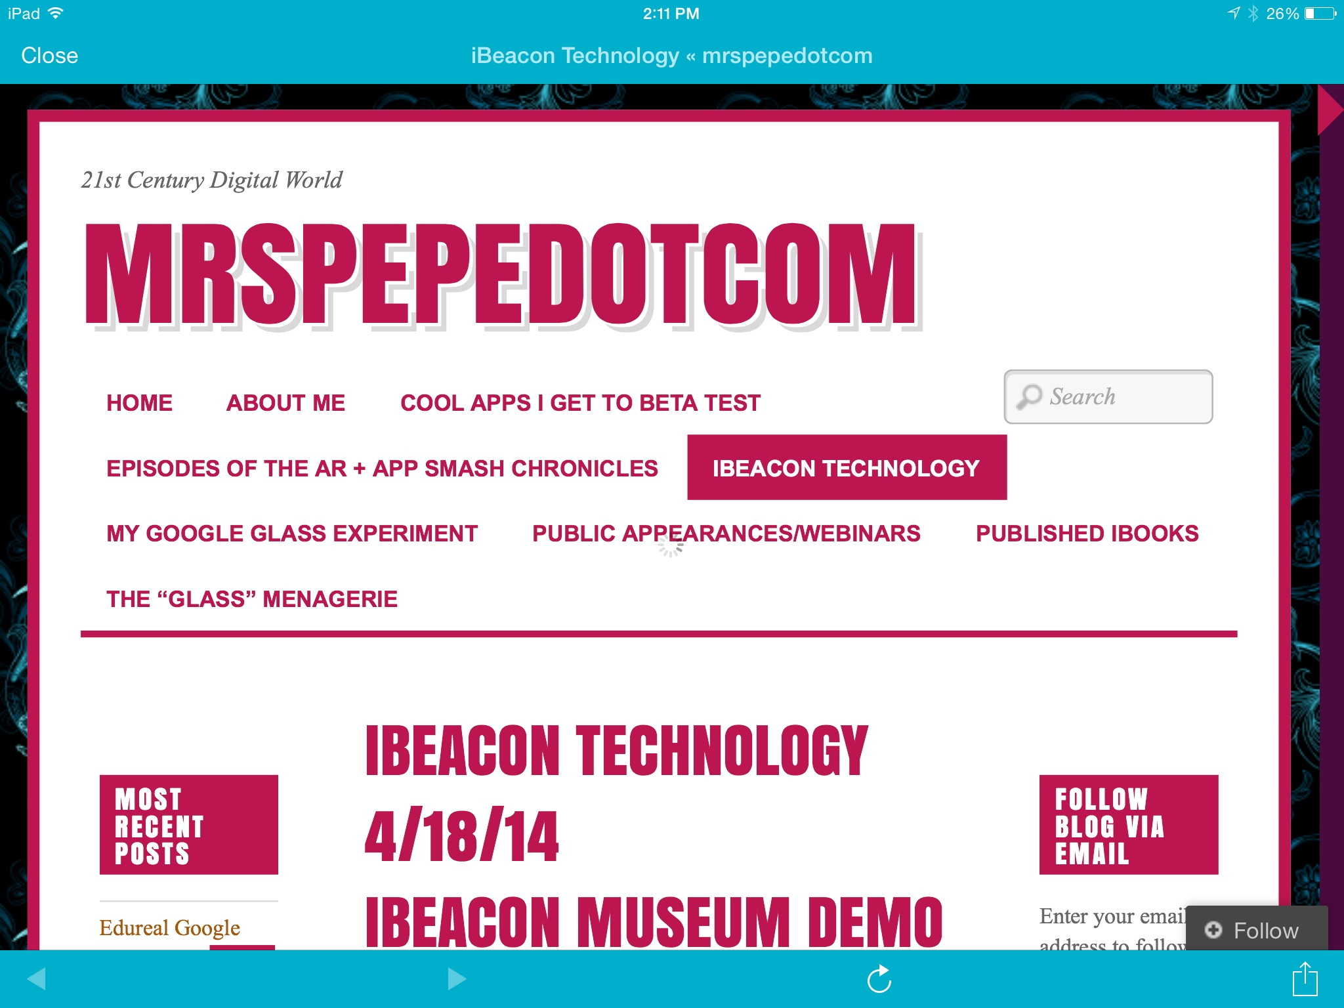
Once I touch the button you can see that it launches the link to my website from within the LAYAR app

Slide 32
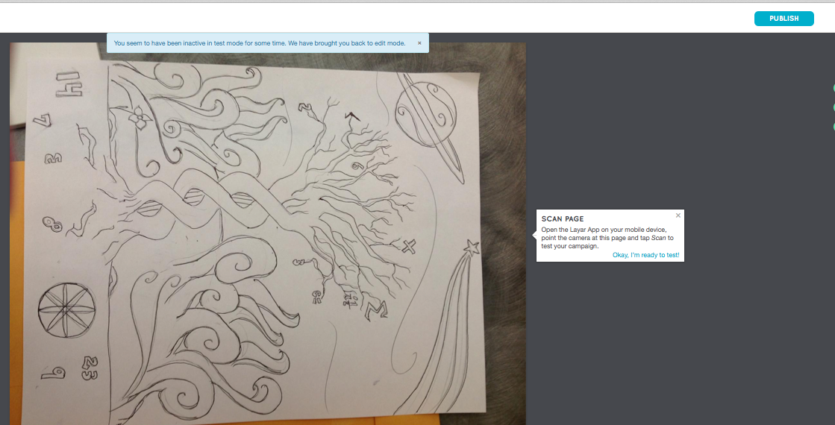
Now that you now the content works you are going to publish your campaign by clicking the button in the upper right hand corner

Slide 33
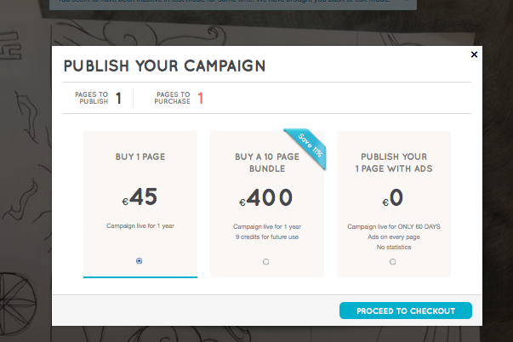
You are going to want to select the FREE option on the right, this publishes the campaign for sixty days for free

Slide 34
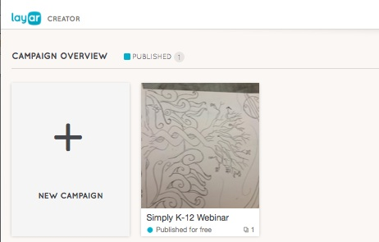
Once you do that your campaign will show up in your dashboard

Slide 35
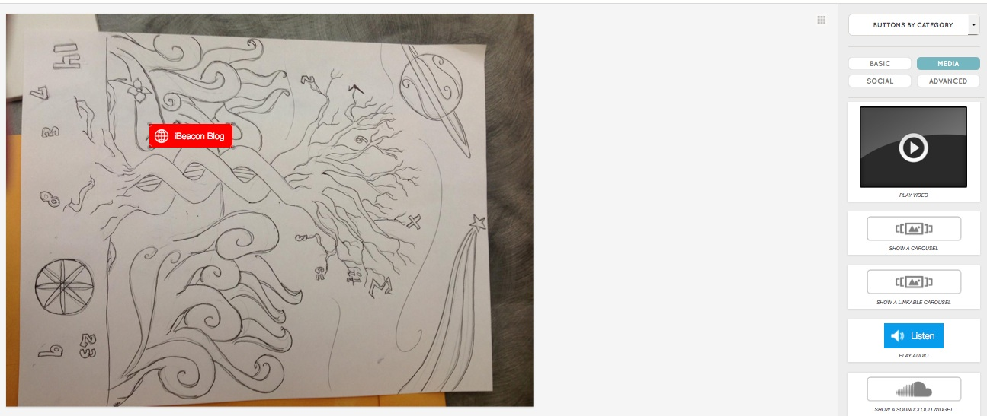
What is nice about LAYAR is that you add multiple buttons to one trigger image, now we are going to add a You Tube Video

Slide 36
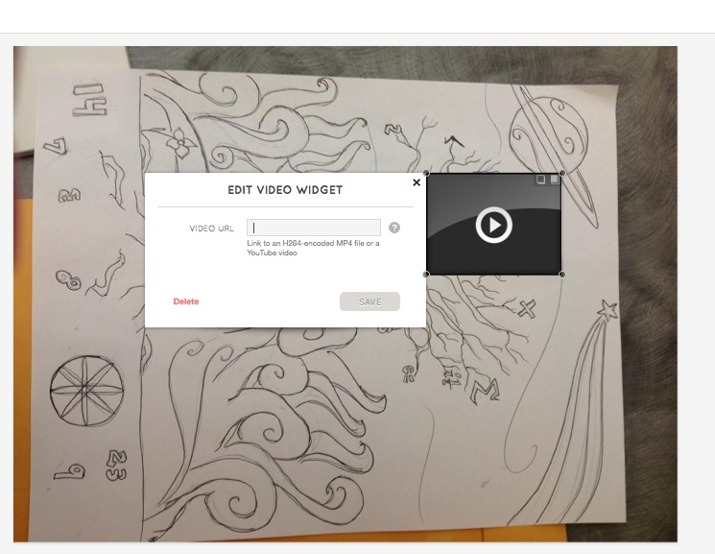
Drop and drag the video widget onto trigger image

Slide 37
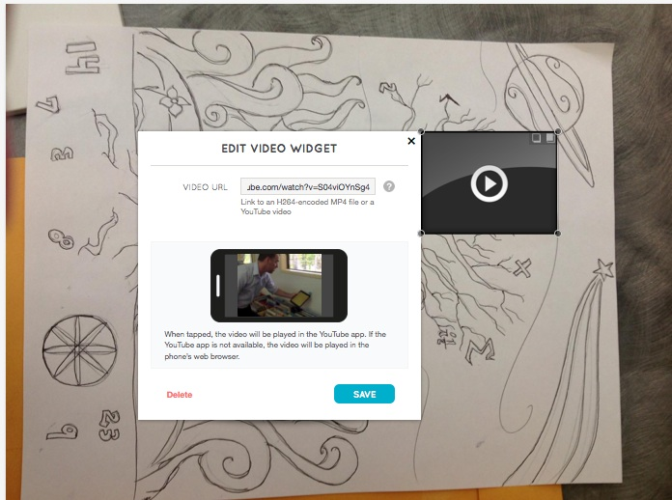
Cut and paste the video you want into the video url box

Slide 38
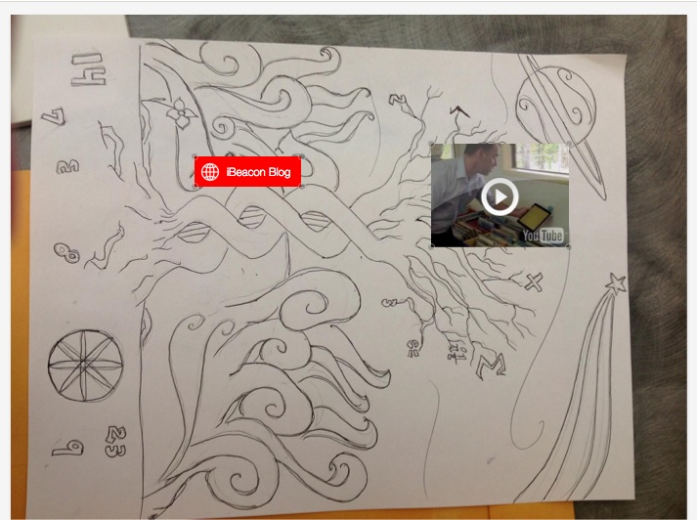
Once you have clicked save you can see that the AR trigger has multiple buttons

Slide 39
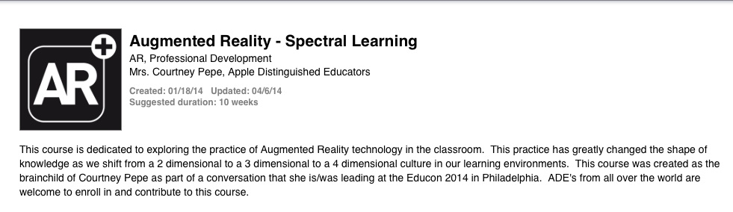
More Free Resources on AR
My iTunes U course – enroll code is
https://itunesu.itunes.apple.com/enroll/EZT-MZE-84E

Slide 40
Contact Me:
mrspepeinmonroe@gmail.com
Follow My Blog at:
http://mrspepe.com/
Follow Me on Twitter @ipadqueen2012
My You Tube Channel is: Device Smashing Diva
This power point will be posted on my blog within the next 48 hours as a resource

